Slide 1
Remedying BGP Myopia:
A Blockchain Solution
Team Sharders
Geoffrey Brendel, Nicholas Anthony, and Joseph Erlinger

Slide 2
Problem Overview: Flaws in the Border Gateway Protocol (BGP)
BGP is vulnerable to prefix and origin hijacking:
Prefix Hijacking: Attacker announces a more specific prefix then its entitled to (Redirects traffic through them).
Origin Hijacking: An AS advertises a prefix that does not belong to its own AS (Traffic is redirected from intended destination to new false advertised AS)
ASes are myopic, so what can we do?
Myopic means ASes do not know the full topology of the Internet.
Imagine a Fog of War

Slide 3
Existing Solution: Resource Public Key Infrastructure (RPKI)
RPKI/BGPSec:
Route Origin Authorizations (ROAs): maintain cryptographically binded AS numbers to specific IP address prefixes.
BGPSec: each hop signs the route before passing it on, creating an encapsulation of security that does not allow for bad actors to maliciously alter the path
Problem:
Requires 100% adoption for 100% security. Security protocol additions are dropped when passed through a router that does not implement the security protocol, & prefixes must have an ROA to prevent being hijacked.

Slide 4
Components of Our Implementation
Our Secure eBGP Router uses
Our Secure eBGP provides
The Killer Feature
Blockchain
Protection against Prefix and Origin Hijacking
< 100 % adoption for 100% Security
Path Verification Algorithm
Protection for ASes outside of network.

Slide 5
First, Some Assumptions
Neighbor announcements are correct. (ASes cannot lie about who their neighbor is).
Static Internet. (e.g. no prefix withdraw)

Slide 7
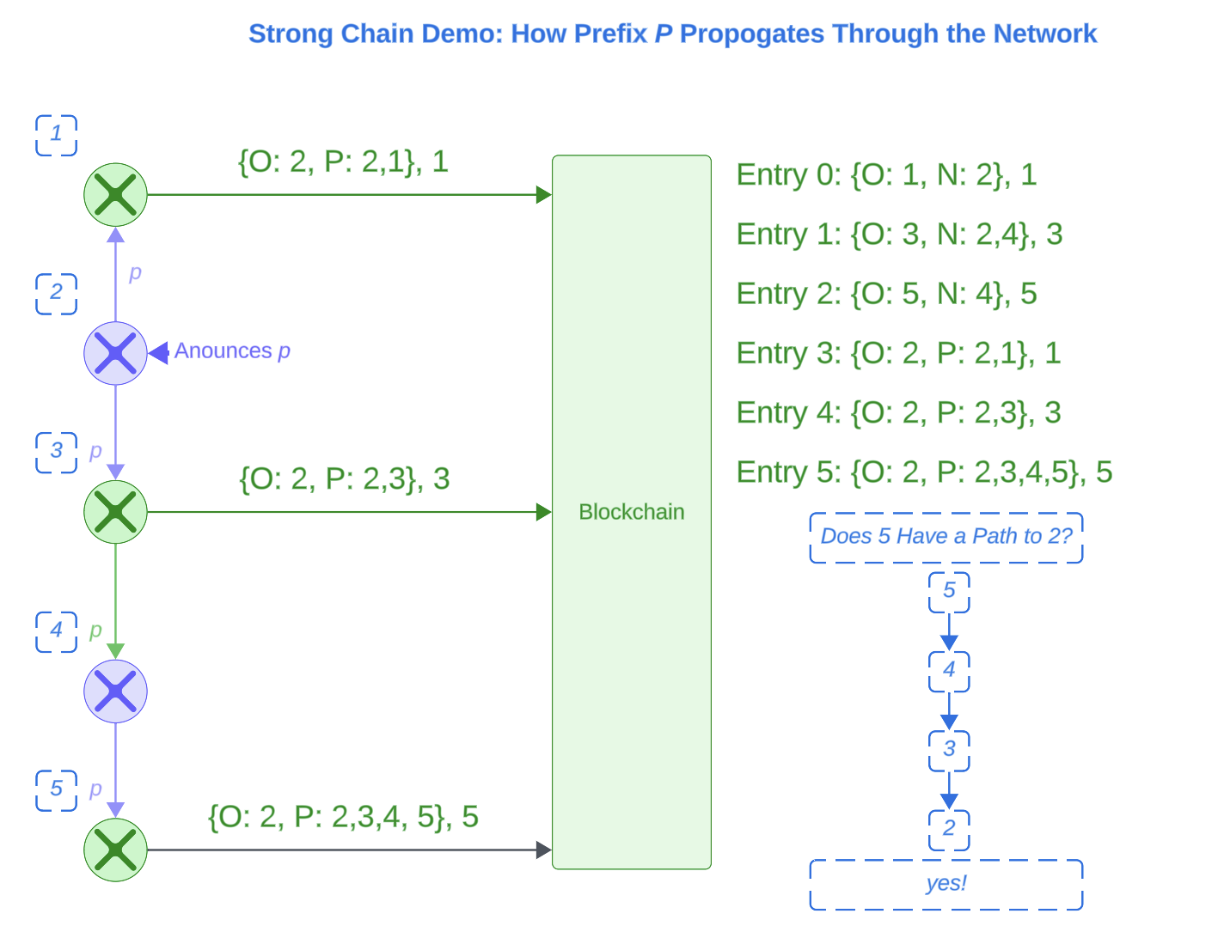

Slide 8
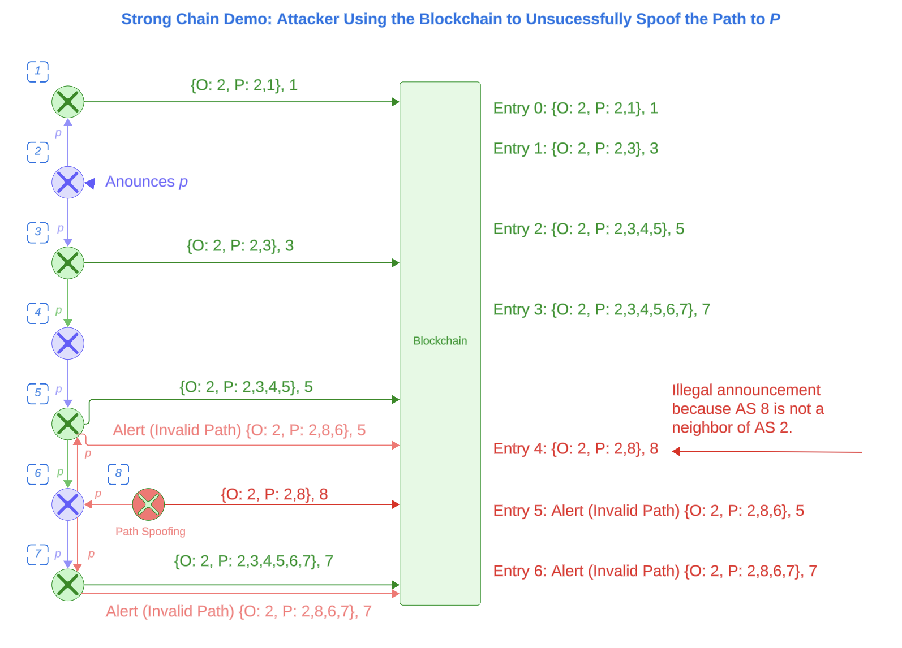

Slide 9
Limitations
Strong Assumptions
Geographic Dependency
Correct neighbor announcements.
Static Internet. (e.g. no prefix withdraw)
A secure route requires every other AS hop to follow our protocol. So, there must be an unbroken chain of routers from A to B.
Vulnerabilities
Without Any Optimizations
First to announce a prefix on the blockchain “owns” it.
Man-in-the-Middle.
Our solution is not optimized for speed. We decided to use trivial algorithms for proof of concept.

Slide 10
Further Research
Neighbor Validation
Nodes claiming to have a neighbor must be proven
Blockchain Controls
Optimizations
Nodes must not be allowed to announce a prefix they do not own.
Optimize our solution for speed and storage.

Slide 11
Q&A

